Slide 1
Recap: off-Policy MC evaluation
Use importance sampling to reweigh experiences
As the environment follows an MDP
The importance weight is the product of the series of actions under two policies
Source of large variance!

Slide 2
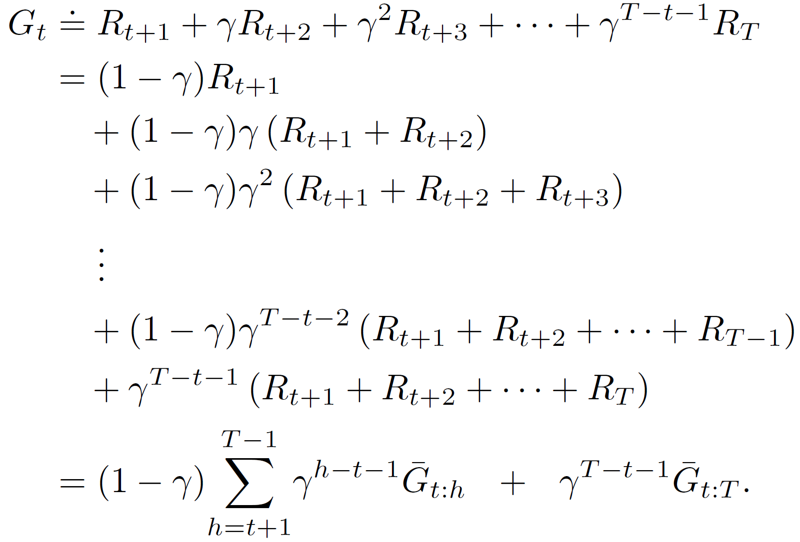
Recap: discounting-aware importance sampling
Direct application of importance sampling causes high variance in value estimation
Importance weight is a product of a series of probability ratios
Return is a sum of an exponentially decaying series!
Will be small!
Flat partial return ${\overline{G}}_{t:h}$

Slide 3
Recap:per-decision importance sampling
The same importance weight for every action in an episode?
A closer look
Under behavior policy

Slide 4
Temporal-Difference Learning
Hongning Wang
CS@UVA

Slide 5
Outline
TD prediction
On-Policy TD control: Sarsa
Off-Policy TD control: Q-Learning
n-step TD methods

Slide 6
Advantages of the RL methods we have learnt?
Monte Carlo methods
Model-free
Evaluation of one state is independent from evaluation on other states – less dependency on Markovian property
Unbiased
Dynamic programming
Model-based
Guarantee to converge to optimal
Exponential convergence

Slide 7
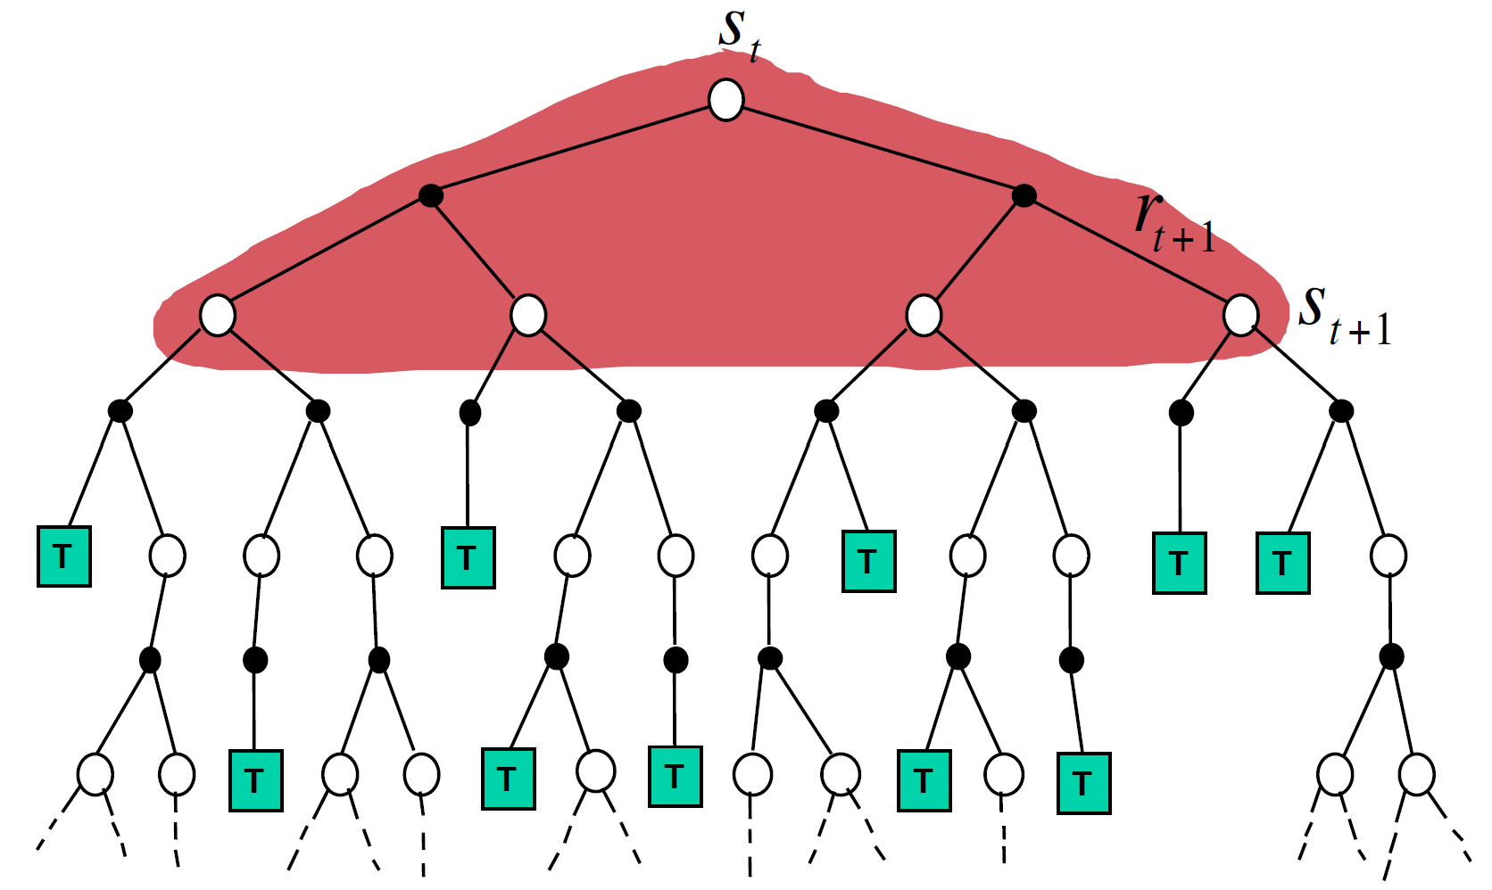
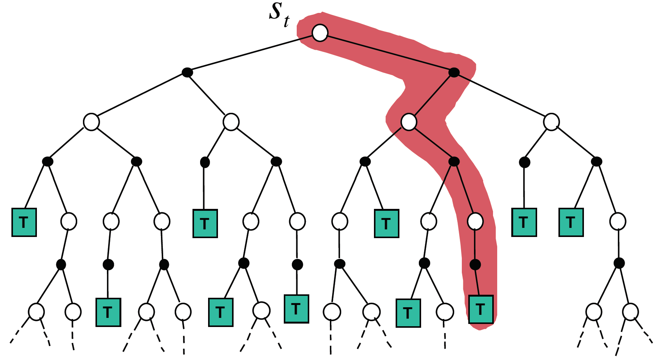
Limitations of the RL methods we have learnt?
Monte Carlo methods
Update per episode - only works in episodic environments
High variance
Dynamic programming
Require complete knowledge of the environment
Figure credit: David Silver, “Model-Free Prediction”

Slide 8
Temporal difference methods
Incremental mean update:
$$μ_{k}=\frac{1}{k}\sum_{i=1}^{k}{x_{i}}=\frac{1}{k}\left(x_{k}+\sum_{i=1}^{k−1}{x_{i}}\right)$$
$=\frac{1}{k}\left(x_{k}+\left(k−1\right)u_{k−1}\right)$
$=μ_{k−1}+\frac{1}{k}\left(x_{k}−u_{k−1}\right)$
A method in between DP and MC
Policy evaluation to begin with
MC: $V\left(s_{t}\right)← V\left(s_{t}\right)+α[G_{t}−V\left(s_{t}\right)]$
DP: $V(s_{t})=R_{π}+γP_{π}^{ss^{′}}V(s_{t})$
A shrinking coefficient
Everything here is known and immediately used
Need an entire episode
$${G_{t}=R}_{t+1}+γR_{t+2}+γ^{2}R_{t+3}+…+γ^{T−1}R_{T}$$
What is this? $V\left(s_{t+1}\right)!$
Vs. MC?
$${G_{t}\dot{=}R}_{t+1}+γV(s_{t+1})$$
Vs. DP?
From the environment
Essentially, this is boot-strapping!
TD(0):
$$V\left(s_{t}\right)← V\left(s_{t}\right)+α[R_{t+1}+γV(s_{t+1})−V\left(s_{t}\right)]$$
From current value estimate

Slide 9
TD(0)
One-step temporal difference
A constant?
Theoretically, we need a shrinking $α$ to guarantee convergence
TD update is a correction based on TD error
TD error

Slide 10
TD vs., MC vs., DP
They all do approximations, but in different components
MC approximates expectation by sampling
DP approximates $v_{π}\left(s_{t+1}\right)$ based on current value estimate
TD approximates $v_{π}\left(s_{t+1}\right)$ based on current value estimate and $R_{t+1}$ by a single sample

Slide 11
TD error
Reminder
The error accumulates

Slide 12
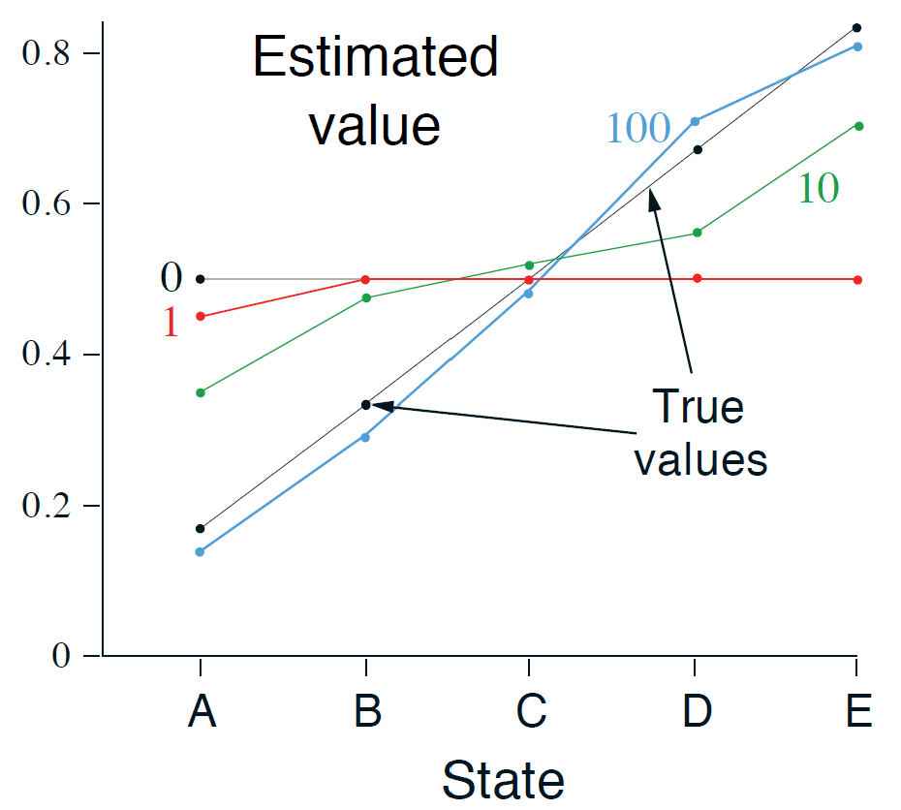
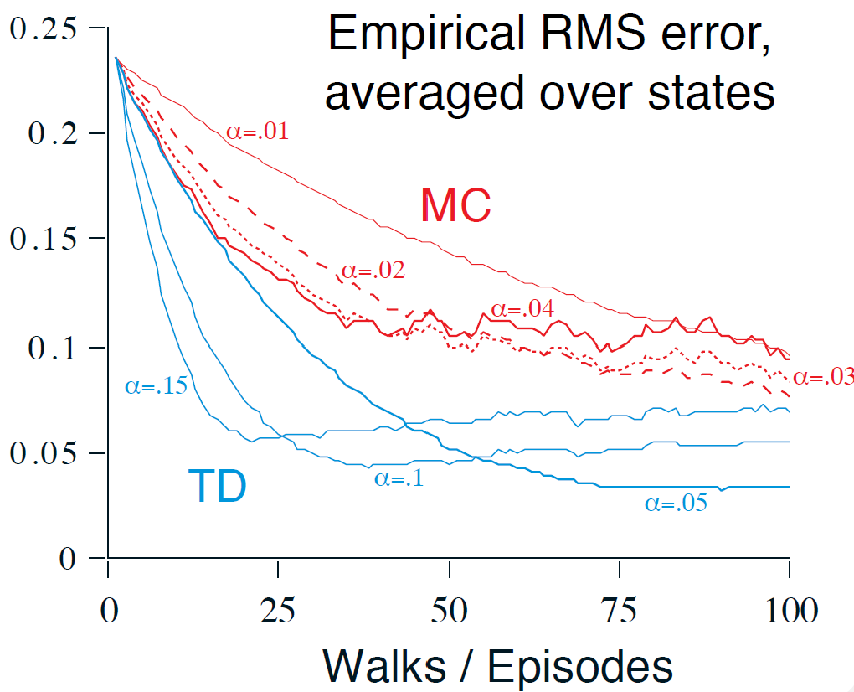
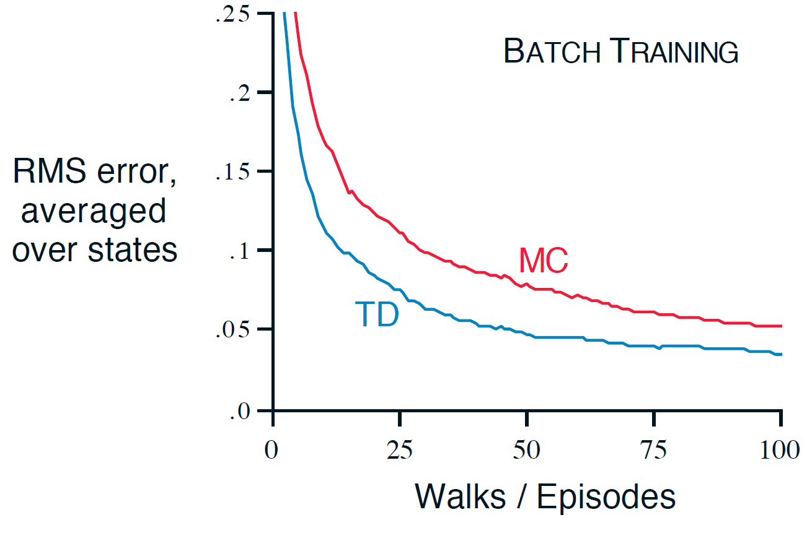
TD vs., MC in a toy example: random walk
How to?
$$1/6$$
$$2/6$$
$$3/6$$
$$4/6$$
$$5/6$$

Slide 13
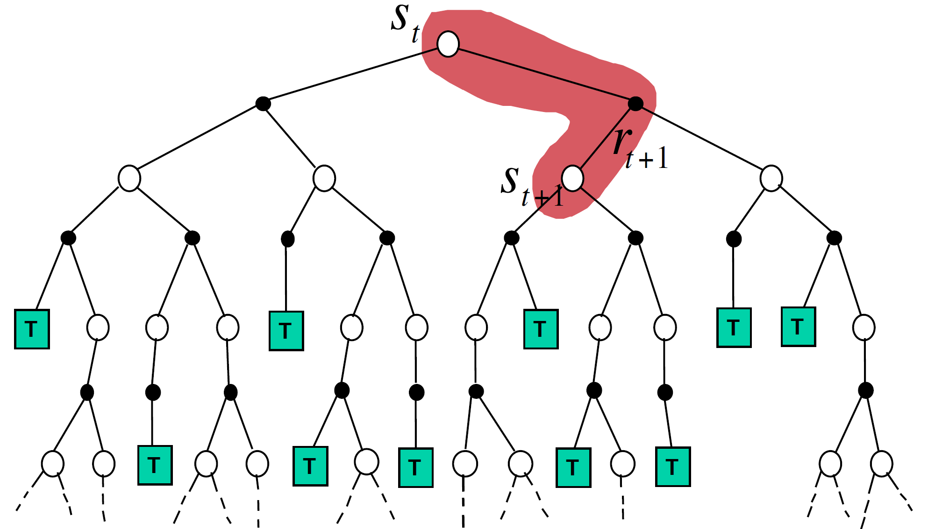
Backup diagram
TD: sampling + bootstrapping

Slide 14
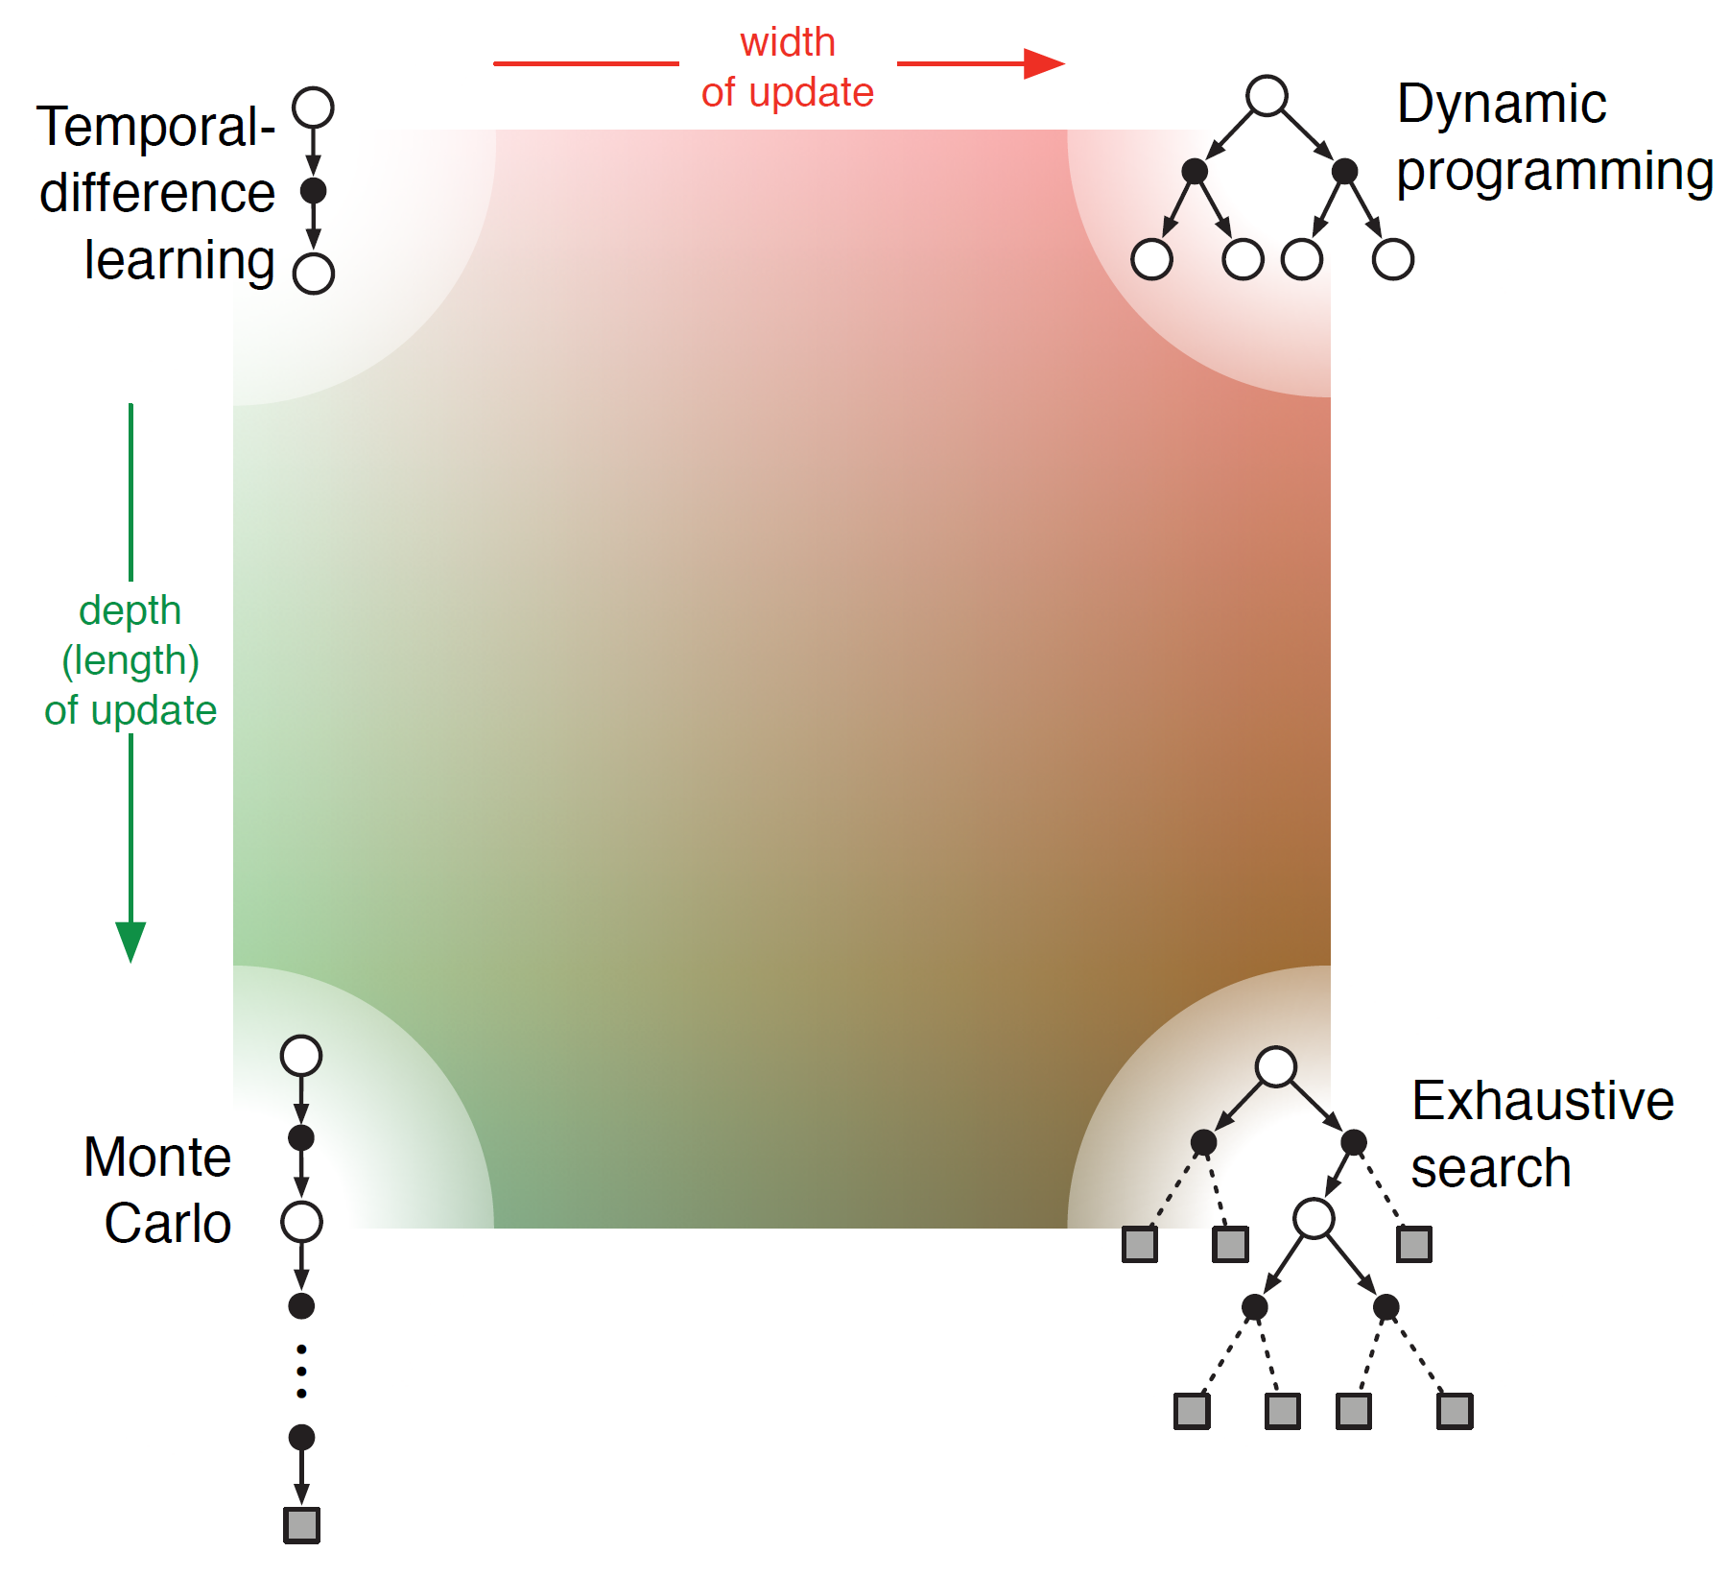
A unified view of RL methods

Slide 15
Optimality of batch TD vs., batch MC in a toy example
Experience replay
Given the following experiences:
Set $γ=1$
$V\left(A\right)=0$ or $6/8$
$$V\left(B\right)=6/8$$
Batch MC minimizes mean square error on training set
Batch TD minimizes negative log-likelihood under Markov process model
MC’s perspective
TD’s perspective

Slide 16
Recap: TD vs., MC vs., DP
They all do approximations, but in different components
MC approximates expectation by sampling
DP approximates $v_{π}\left(s_{t+1}\right)$ based on current value estimate
TD approximates $v_{π}\left(s_{t+1}\right)$ based on current value estimate and $R_{t+1}$ by a single sample

Slide 17
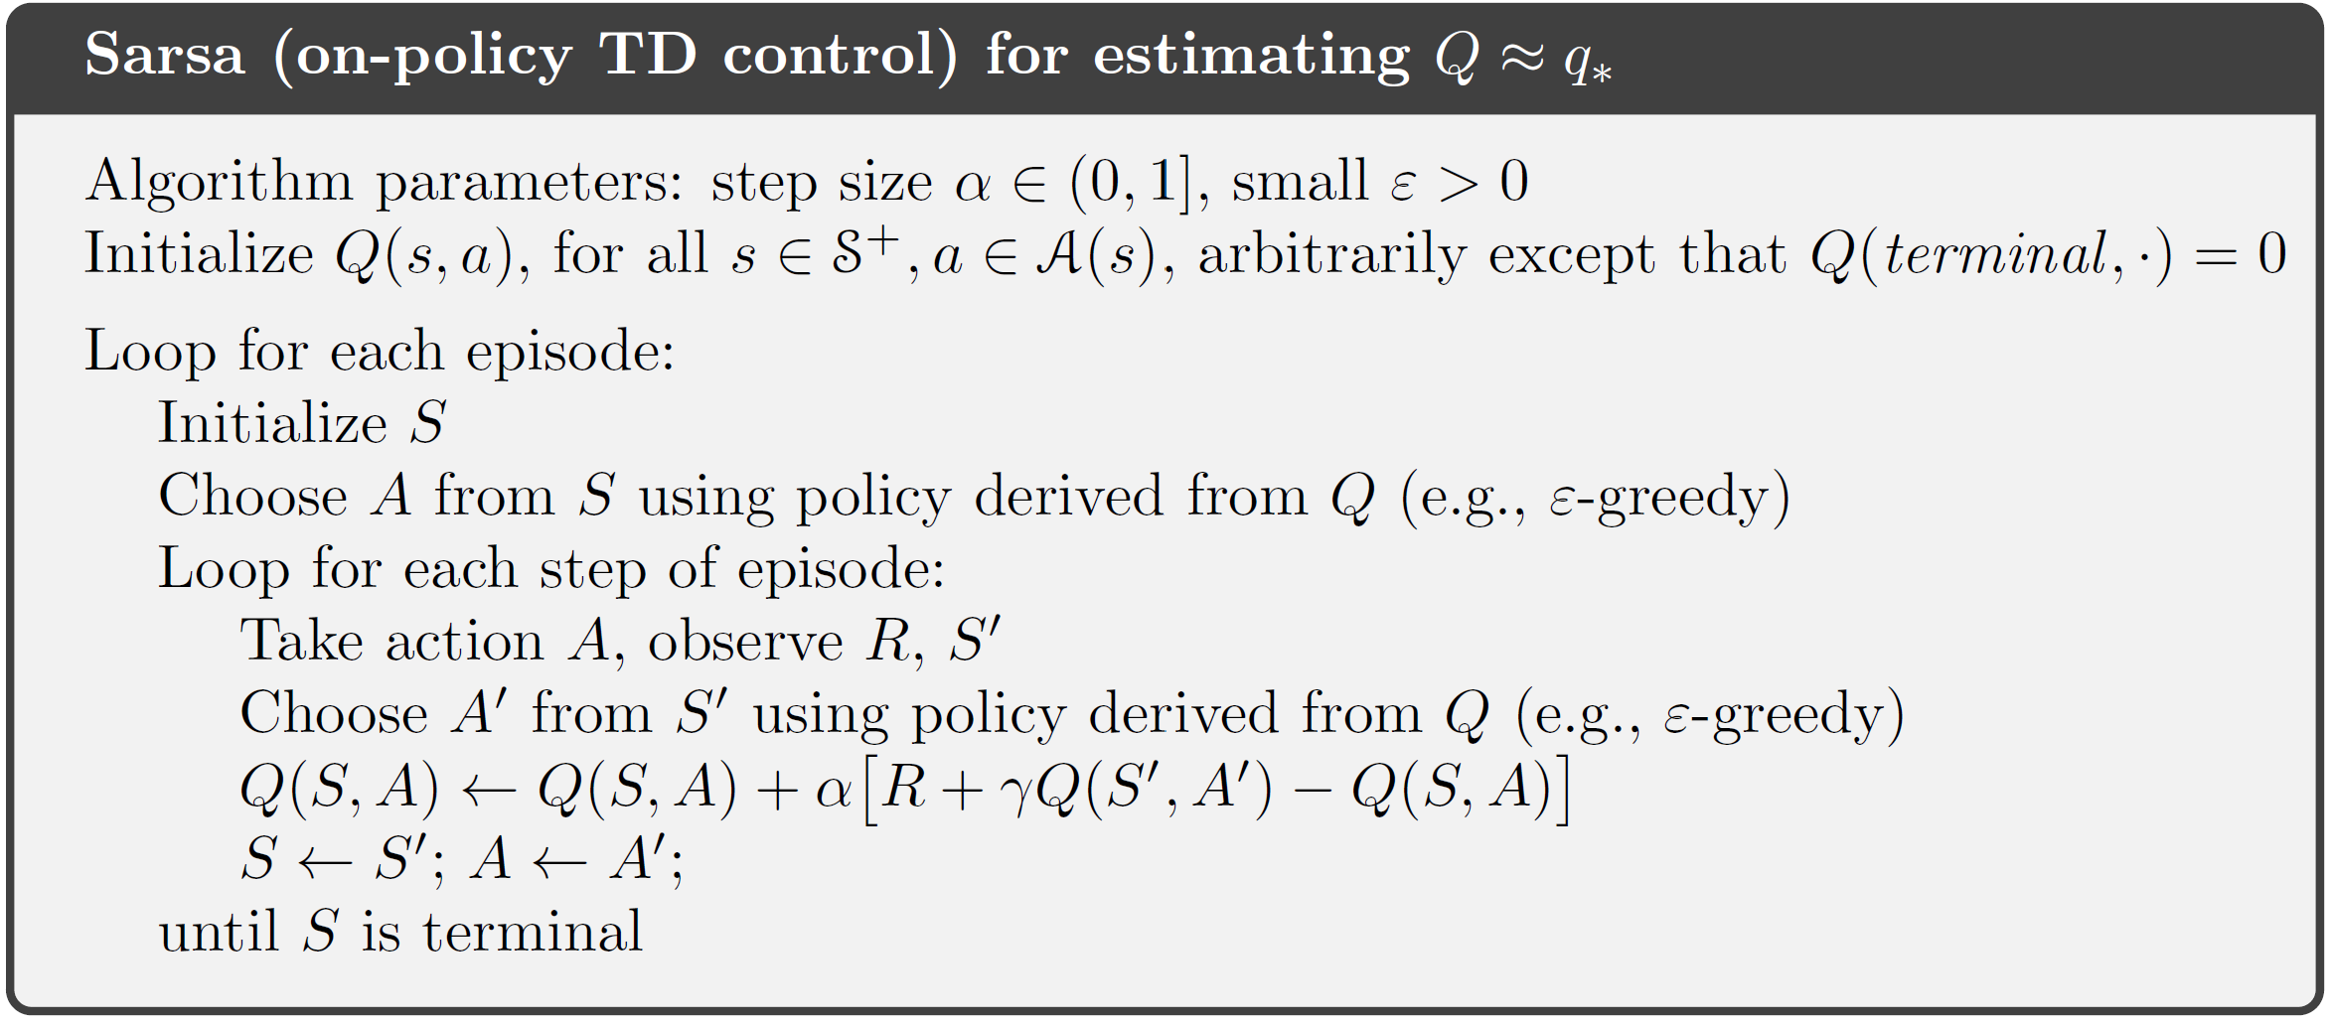
On-Policy TD control: Sarsa
Learning the action value function using TD method
Exploration? Everything we have learnt about it applies here!

Slide 18
Off-Policy TD control: Q-learning

Slide 19
Sarsa vs., Q-learning
Why is it off-policy?
greedy!

Slide 20
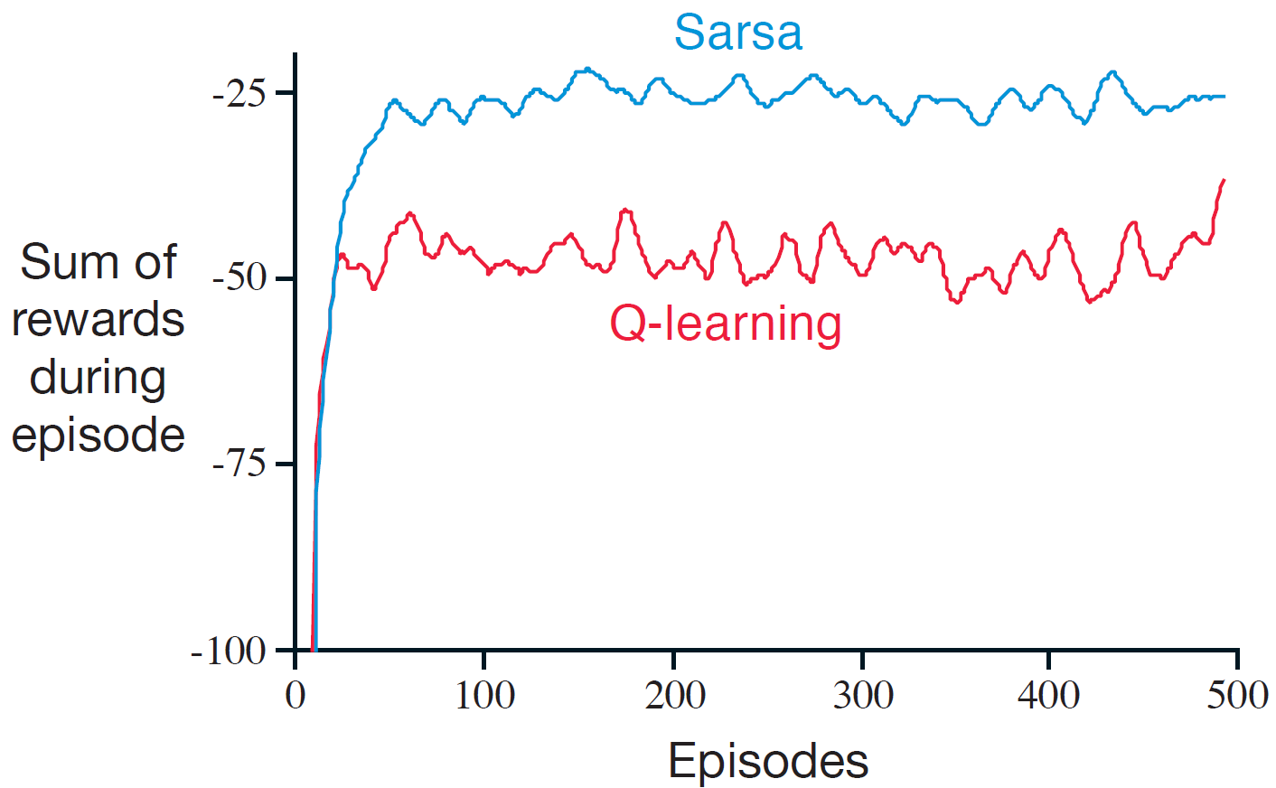
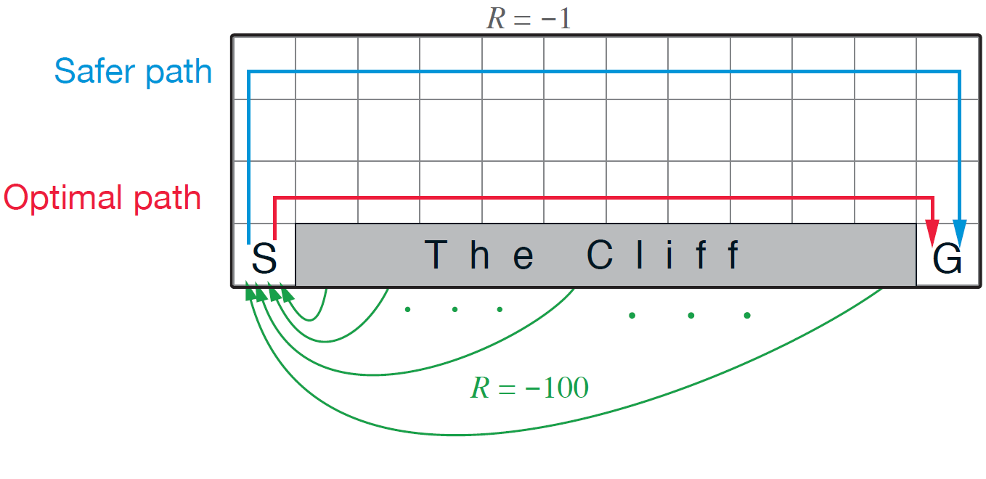
Sarsa vs., Q-learning in a toy example
Randomness comes from policy, rather than environment in this example!

Slide 21
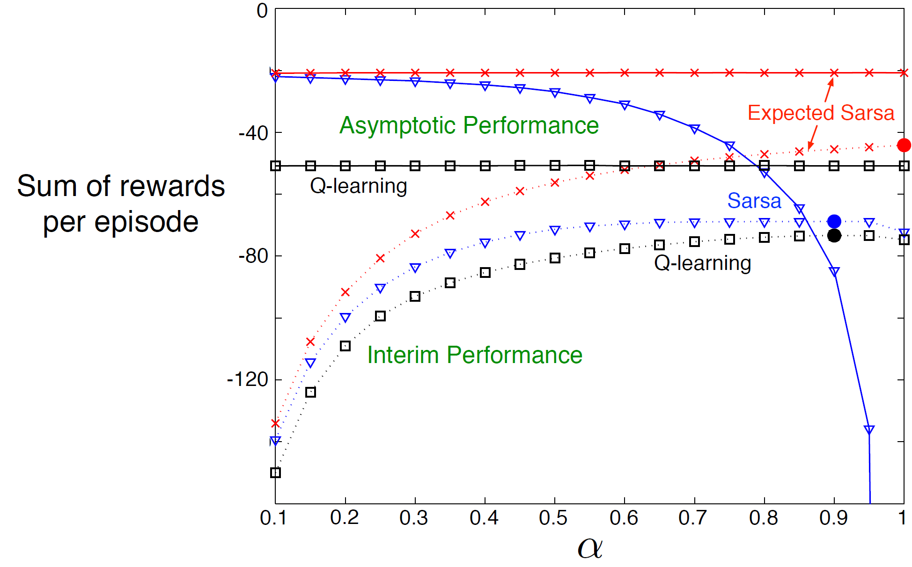
Expected Sarsa
Instead of sampling one action for next state, compute the expectation
Is this on-policy or off-policy?
100k episodes
100 episodes

Slide 22
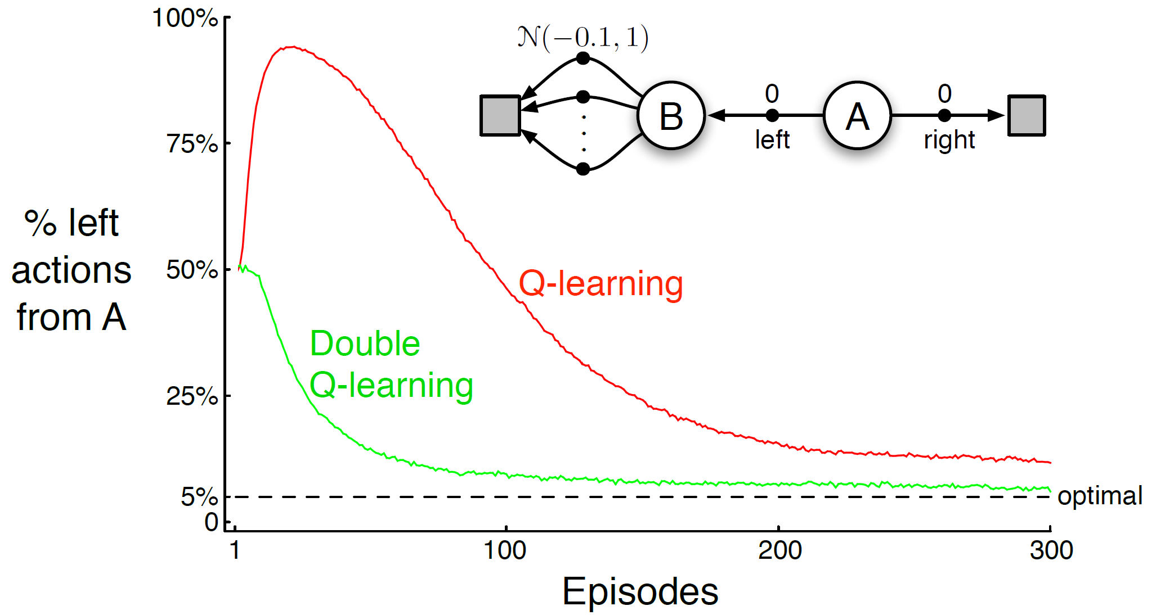
Maximization bias
We use maximum to choose an action and also treat it as an estimate of the maximum of the true value
Q-learning as an example

Slide 23
Double Q-learning
Unbiased estimate for each other!

Slide 24
n-step temporal difference methods
A method in between DP and MC
Policy prediction to begin with
MC: $V\left(s_{t}\right)← V\left(s_{t}\right)+α[G_{t}−V\left(s_{t}\right)]$
DP: $V(s_{t})=R_{π}+γP_{π}^{ss^{′}}V(s_{t})$
Everything here is known and immediately used
Need an entire episode
$${G_{t}=R}_{t+1}+γR_{t+2}+γ^{2}R_{t+3}+…+γ^{T−1}R_{T}$$
What is this? $V\left(s_{t+2}\right)!$
We have to wait one more step!
$${G_{t}\dot{=}R}_{t+1}+γR_{t+2}+γ^{2}V(s_{t+2})$$
From environment
TD(1):
$$V\left(s_{t}\right)← V\left(s_{t}\right)+α[R_{t+1}+γR_{t+2}+γ^{2}V(s_{t+2})−V\left(s_{t}\right)]$$
From current value estimate

Slide 25
n-step temporal difference methods
A more flexible way to strike a balance between TD and MC
n-step sampled return
bootstrapping
no update until we collect n samples!

Slide 26
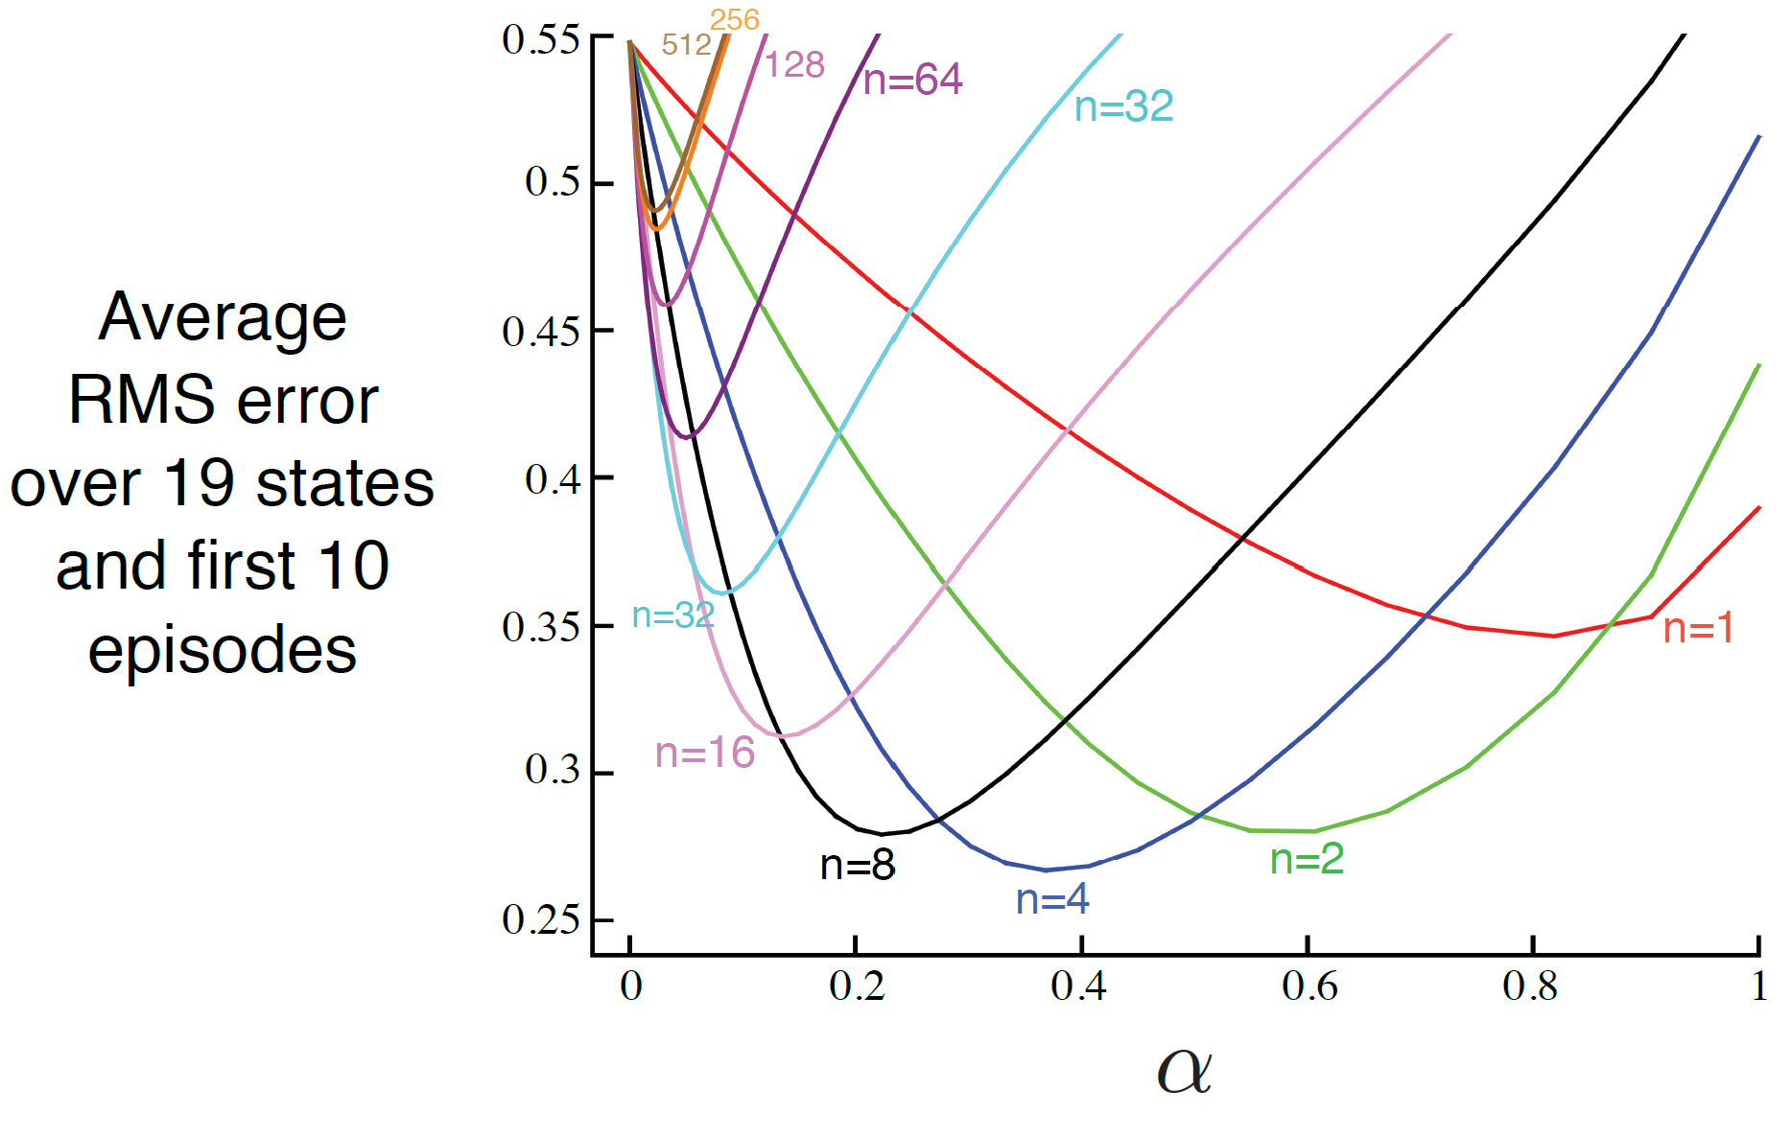
Choice of $n$ in the toy example
Policy prediction task

Slide 27
Recap: Sarsa vs., Q-learning
Why is it off-policy?
greedy!

Slide 28
Recap: double Q-learning
Unbiased estimate for each other!

Slide 29
Recap: n-step temporal difference methods
A more flexible way to strike a balance between TD and MC
n-step sampled return
bootstrapping
no update until we collect n samples!

Slide 30
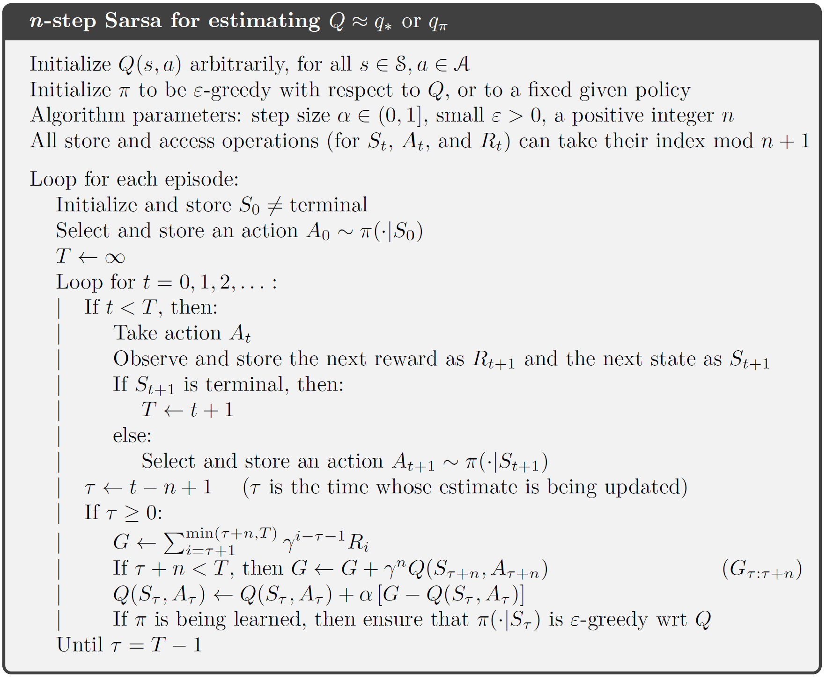
n-step Sarsa
length-n window to collect samples
No incremental update this time

Slide 31
n-step Sarsa
n-step return is a series of TD corrections
n-step excepted Sarsa
Discount for time $t+k$
predicted value of $A_{t}$ at $S_{t}$ at time $t$
TD error/correction of $A_{t+k}$ at $S_{t+k}$ at time $t+k$

Slide 32
n-step off-policy learning
The same principle as in episodic off-policy MC
Techniques used in off-policy MC for controlling variance of this weight also apply here
Discounting-aware importance sampling
Per-decision importance sampling
How about n-step Q-learning??

Slide 33
n-step off-policy learning: Tree Backup
Without importance sampling
One-step: Q-learning, expected Sarsa
We have sampled observations (e.g., from behavior policy)
Kind of expected Sarsa
We do not have any observations;
use current estimate instead!
recursion appears!
Why is it an off-policy method?

Slide 34
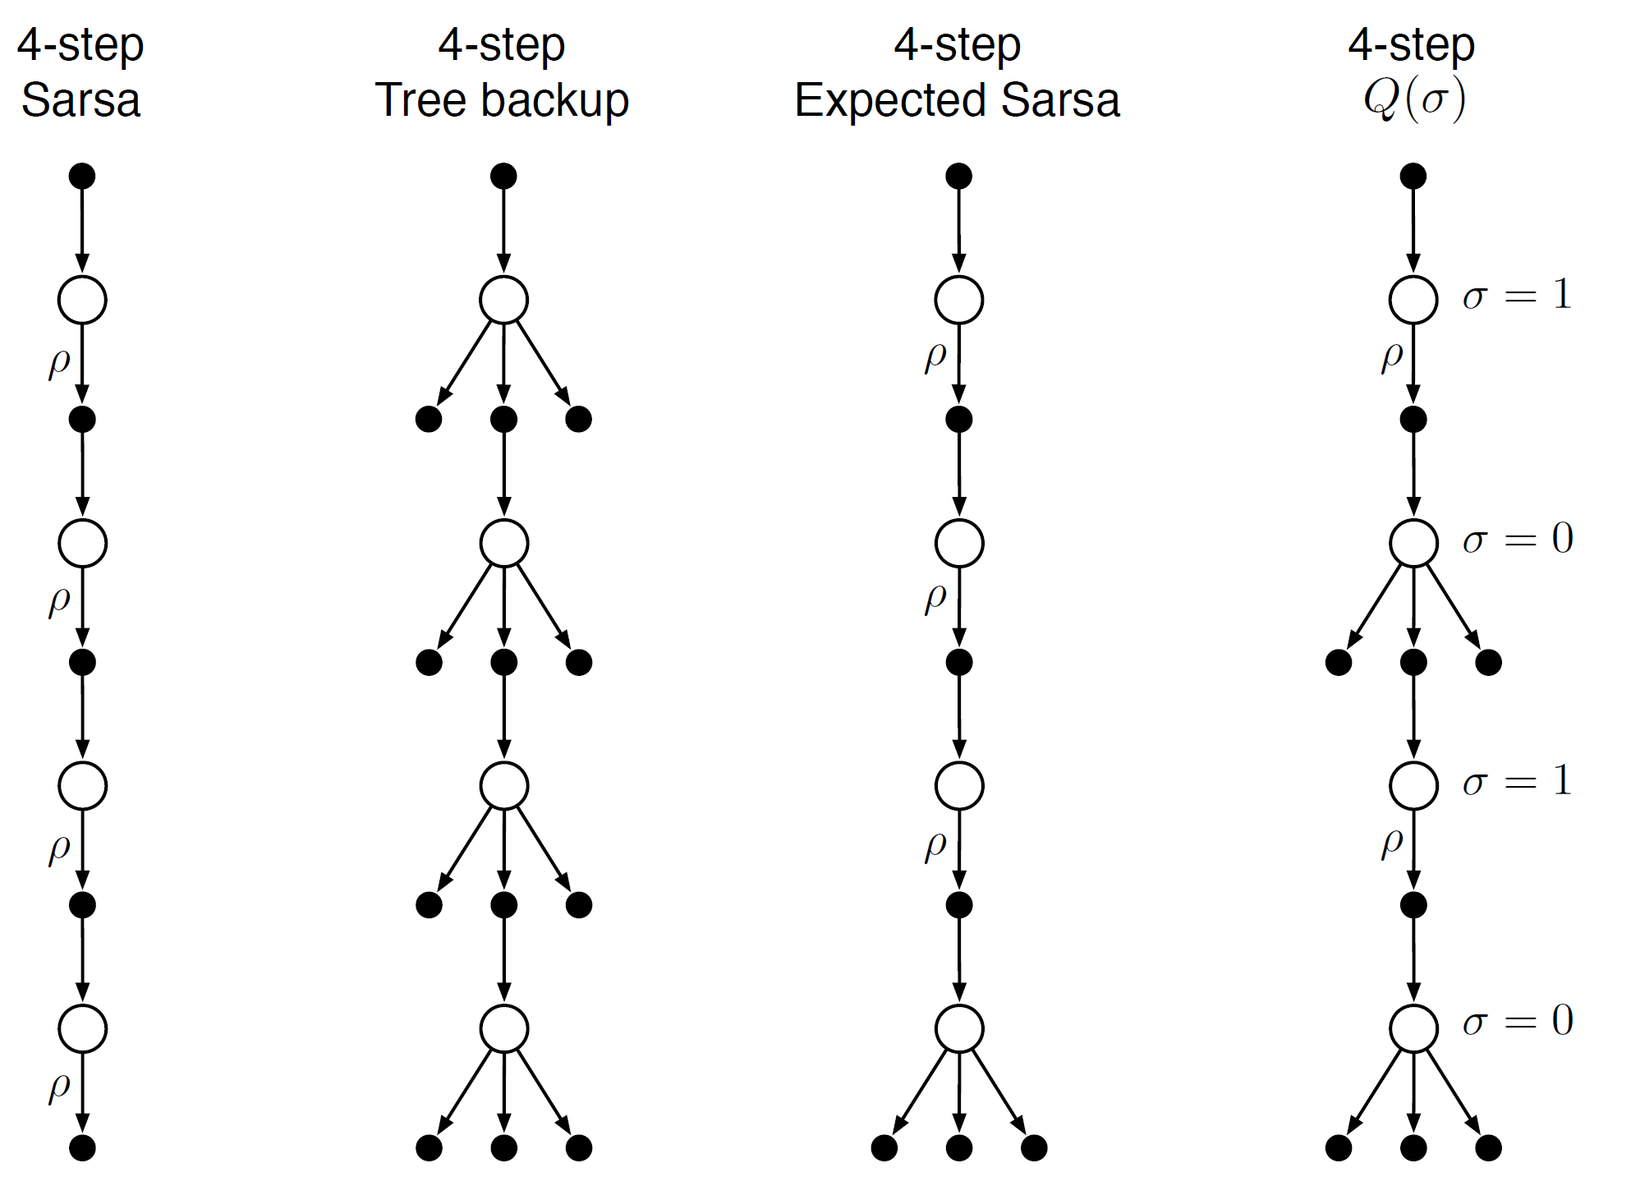
Unifying all n-step TD methods
The most unified method, $σ$ controls whether to sample an action

Slide 35
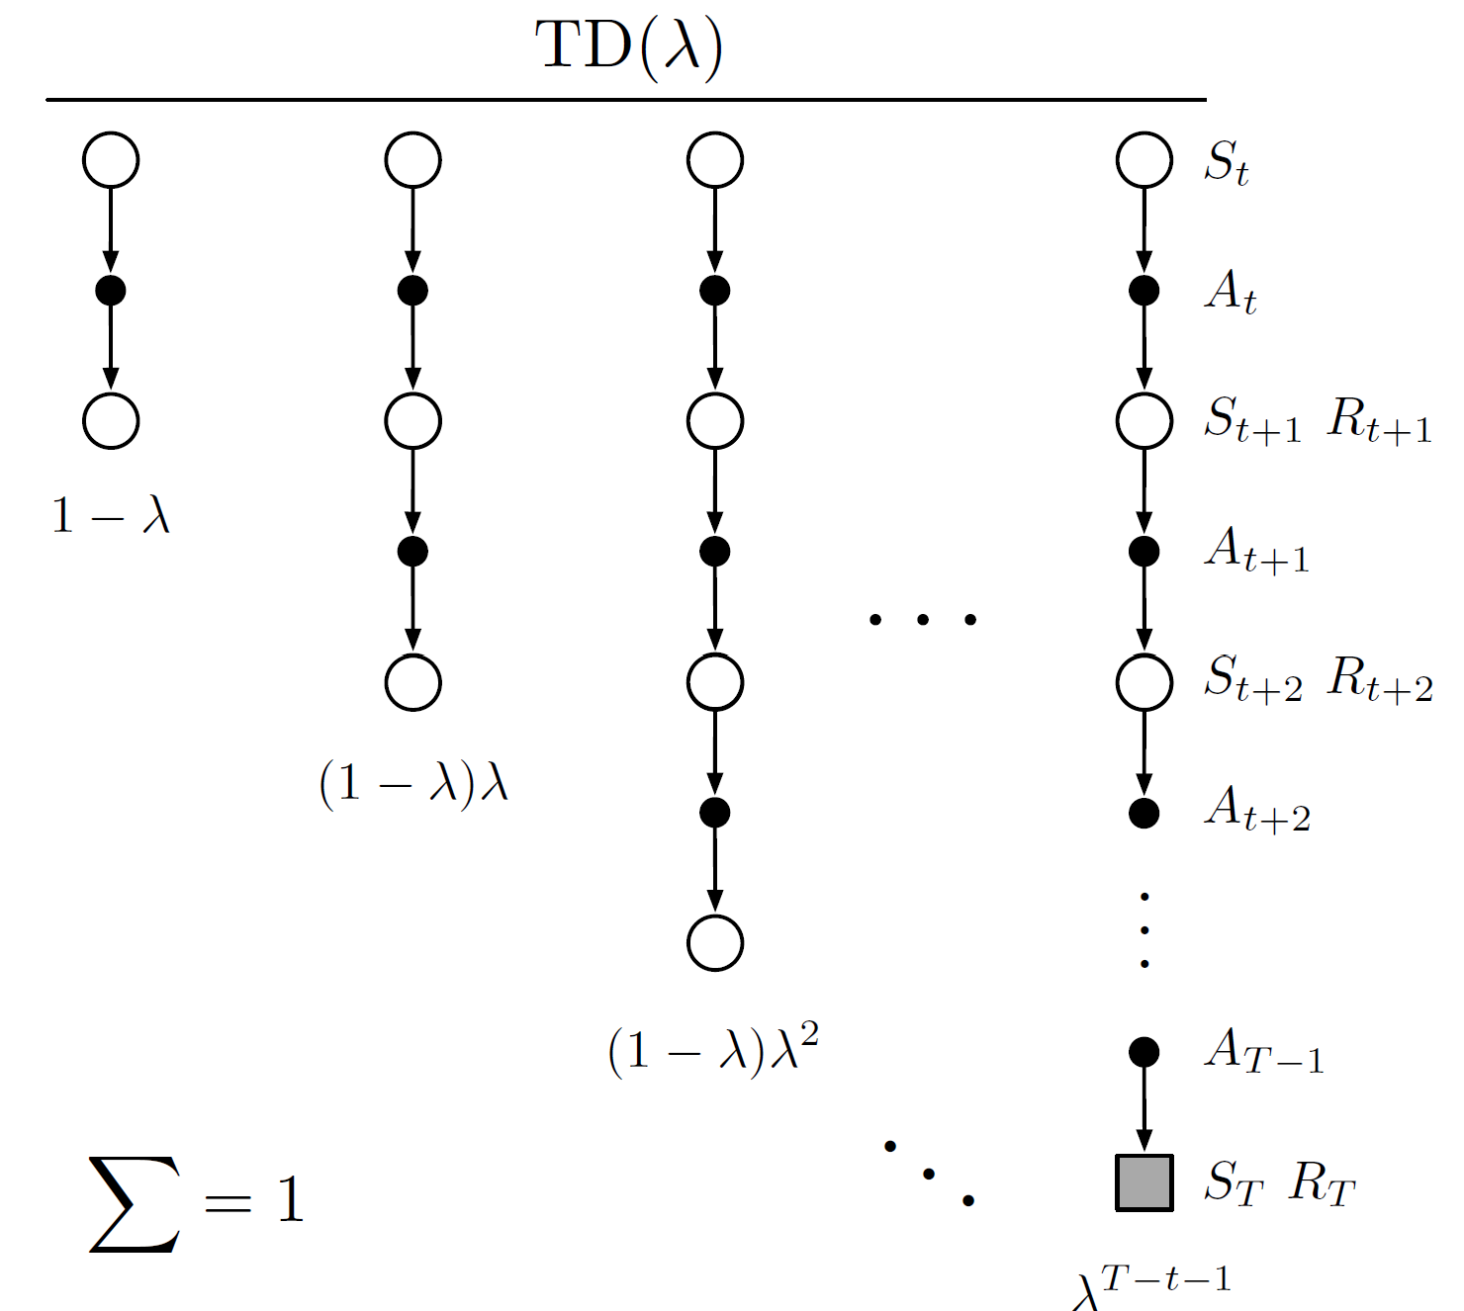
Unifying n steps in TD methods
Do we have to wait until n steps for a valid update?
$λ$-return:
Soft version of n-step return, without explicit n
Weight the return so far

Slide 36
Recap: discounting-aware importance sampling
Direct application of importance sampling causes high variance in value estimation
Importance weight is a product of a series of probability ratios
Return is a sum of an exponentially decaying series!
Will be small!
Flat partial return ${\overline{G}}_{t:h}$

Slide 37
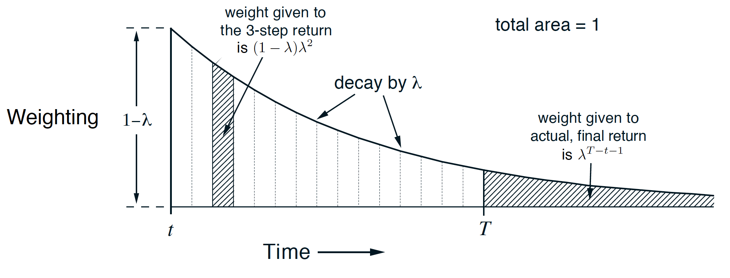
Unifying n steps in TD methods
Do we have to wait until n steps for a valid update?
$λ$-return:
Soft version of n-step return, without explicit n

Slide 38
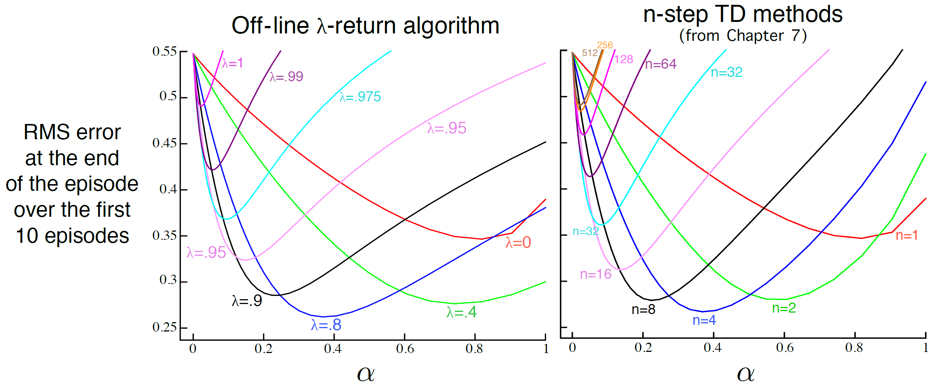
$λ$-return vs. n-step TD

Slide 39
Takeaways
The essence of temporal difference methods is bootstrapping
No need to wait until an episode is finished
On-policy vs., off-policy TD methods
n-step TD vs., n-step $Q(σ)$
n-step TD v.s., TD($λ$)
No need to wait until n steps are finished

Slide 40
Suggested readings
Chapter 6: Temporal-Difference Learning
Chapter 7: n-step Bootstrapping
Chapter 12: Eligibility Traces

